Slide 1

Developments in the UK
Nicholas Bevan
European minimum standards
National implementation

Slide 2
Evolving Rights
The Motor Insurance Directives
First (72/166/EC) 24/04/1972 | Duty to ensure TP insurance cover, art 3
Second (84/5/EC) 30/12/1983 | Set up body to compensate victims of uninsured & untraced drivers, art 2.4 Passenger knowledge exception, art 2.4 Inclusion of property damage, art 1.1 Minimum levels of compensation, art 1.2 List of exclusions void against victims, art 2.1 Permitted stolen vehicle exception, art 2.1
Third (90/232/EC) 14/05/1990 | Extends TP cover to passengers, art 1 Gaps in cover to be closed and high level of consumer protection required, recitals 5 & 13
Fourth (2000/26/EC) 16/05/2000 | New cross border remedies
Fifth (2005/14/EC) 11/05/2005 | Increases minimum levels of protection
Sixth (2009/103 EC) 07/10/2009 | Consolidating directive
EU legislative objectives almost fully evolved by 1990

Slide 3
Evolving CJEU Principles
Defining the rights conferred under the MID
Protective purpose
  Bernaldez 1996
  Candolin 2005
  Farrell v Whitty 2006
  Vnuk 2014
Directives objectives not to be undermined
  Candolin 2005
Equivalence & Effectiveness of the protection
  Evans 2005
Circumscribed role of the Compensation Body
  Churchill v Wilkinson 2011
  Csonka v Allam 2013

Slide 4

6 Culminating Principles
The TP motor insurance requirement [Art 3]
The duty and scope of the TP motor insurance requirement are coextensive
The TP cover extends to
    Almost any use
    Almost any motorised vehicle
    Anywhere on land
Member states have no discretion
    They can’t introduce their own exclusions or restrictions of liability

Slide 5
6 Culminating Principles
On the Compensating Body (MIB) [Art 10]
MIB’s role is strictly circumscribed:
    Untraced, or
    Where absolutely no insurance in place, or
    Where passenger knows vehicle stolen, art 13
MIB must compensate at least up to the limits of the TP insurance obligation
    In doing so it must apply the EU law principles of equivalence and effectiveness
Only one permitted exclusion of MIB liability
    Passengers who enter knowing vehicle uninsured , art 10.2
    Untraced claims - €500 excess + property damage exclusion where no ‘significant injury’

Slide 6
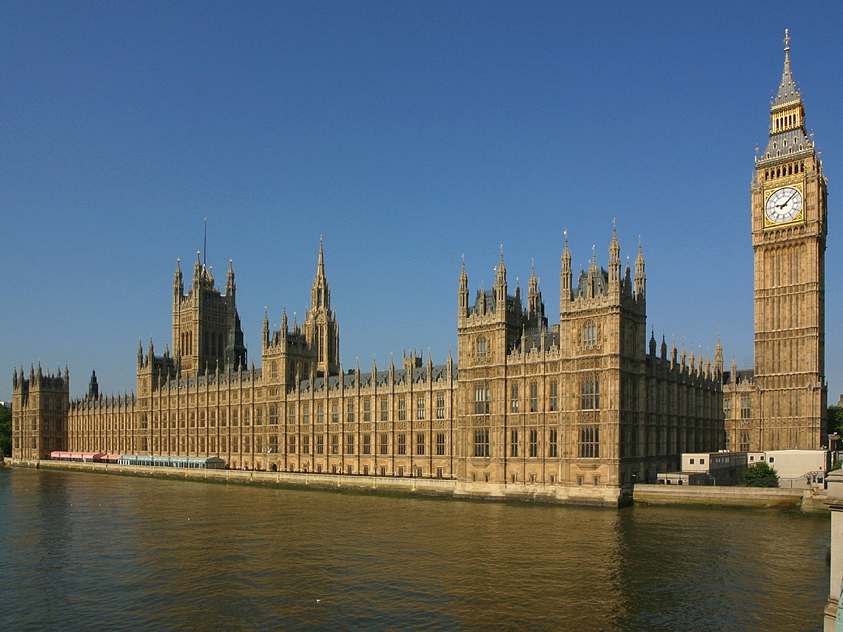

UK Regulatory and Social Policy Protection
  The Road Traffic Act 1988
  Various statutory instruments
  Case law and precedent
  The MIB Agreements
6

Slide 7

83 years of statutory evolution
Road Traffic Act 1930, Part II
  s 35 Duty to Insure against TP
  s 36 Requirements of TP policies
  s 38 Nullifying certain conditions precedent in policies
  s 40 Duty to provide insurance information
Road Traffic Act 1934, Part II
  s 10 Insurers to satisfy judgments for TP liabilities
  s 11 Bankruptcy of insured
  s 12 Nullifying certain exceptions in TP policies
Sir Felix Cassel’s report of 1937
Road Traffic Act 1960, Part VI – consolidating
Road Traffic Act 1972, Part VI - implementing EU law
Road Traffic Act 1988, Part VI – consolidating and updating

Slide 8

COMPARATIVE LAW
8

Slide 9
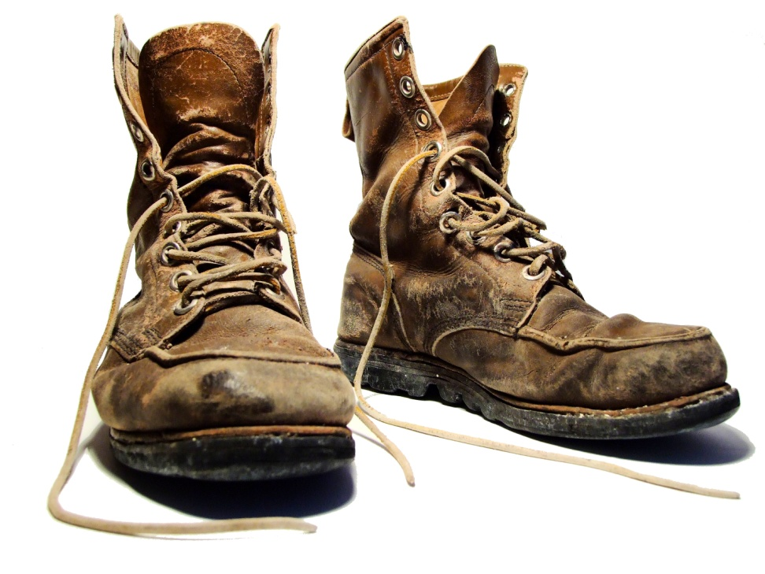
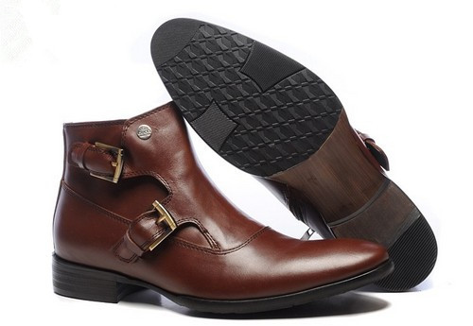
Comparing UK and EU law
UK TP Protection
EU law TP Protection
A subrogated right
A free-standing right

Slide 10

Third Party Insurance Requirement
United Kingdom v European Union
Qualified scope
  Confined to
    Certain places
    Certain types of vehicle
    Certain kinds of use
Contractual restrictions
  Only modified by statute
  Limited number of exclusions nullified by statute
  Otherwise, insurers are free to exclude or restrict TP cover
    EUI v Bristol Alliance 2012
    r3 Rights A’ Insurers Regs 2002
Inclusive scope
  Fit for purpose
    Any vehicle, any use, any place
    Only 1 contractual liability exclusion
No contractual restrictions
  Unless expressly permitted by Dir’
    Passenger knows vehicle stolen
Practically no user restrictions
  Use consistent with normal function of vehicle

Slide 11
Motor Insurers Bureau
United Kingdom v European Union
Qualified liability
  Uses RTA 1988 definitions
  Numerous liability exclusions
  Various restrictions / deductions
  Numerous procedural strike out clauses
Enhanced role
  EUI v Bristol Alliance 2012
    Insufficiently insured driver claims treated as uninsured
    Endorses misconceptions about article 75
    See notes p 4
Comprehensive liability
  the task of providing compensation, at least up to the limits of the insurance obligation
  Principles of equivalence and effectiveness
  Only 1 MIB liability exclusion
Circumscribed role
  A last resort where
    No insurance at all
    Untraced vehicle
  No discretion to extend
    Cant serve as a second-tier claims service for insurers

Slide 12
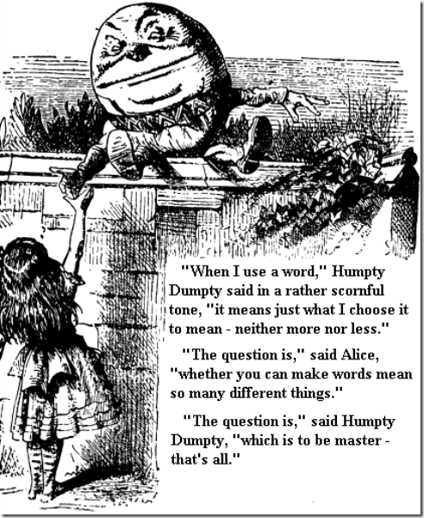
Lack of legal Certainty
Over 40 instances where the plain literal meaning of UK law conflicts with EU law
s151(8) RTA not amended after Churchill case in 2011
The MIB Agreements are replete with illegality
Courts adopt inconsistent approach to construction
Lack of legal certainty = a free standing infraction
  Case C-365/93 Commission v Greece 1995

Slide 13

10 areas of concern
With the UK Transposition
Restrictions in scope
Exclusions of liability
Procedural mechanisms that undermine the effectiveness of the directives
Insurers right of recovery
Direct right against insurers
Derogated vehicles gap
Misallocation of claims as uninsured
Discrimination against minors under the UDA 2003
Unlawful deductions from compensation
Lack of legal certainty

Slide 14
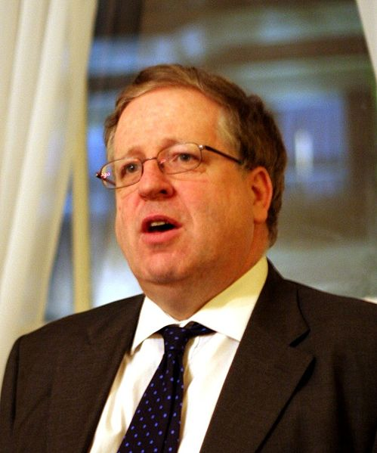
Consultation on MIB Agreements
Consultation
  28 Feb – 28 Apr 2013
  Proposals confined to procedural issues
  Proposes illegal clause
  Fails to address non-compliance with EU law
  Rejects dialogue
  Fails to deliver full report
  Misses own April 2014 target for new Uninsured Drivers Agreement
Patrick McLoughlin
Secretary of State for Transport

Slide 15
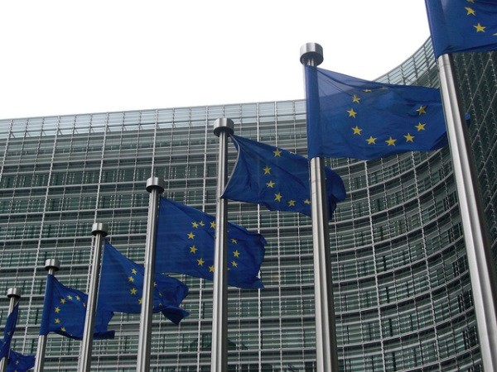
Bevan v United Kingdom (CHAP(2013)02537)
Key Themes
Unlawful restrictions in scope of TP insurance
  Geographic
  Technical
Unlawful exclusions
Unlawful deductions
Unlawful restriction in direct right
Misallocation of claims as uninsured
Unlawful and disproportionate procedural strike-out clauses
Lack of legal certainty

Slide 16
Uninsured Drivers Agreement 2015
A long road to an unsatisfactory destination...
  2007 Meetings with MIB
  2009 Series of articles criticising MIB Agreements
  2013 Four New Law Journal articles
  2013 Consultation on MIB Agreements
  2013 Infringement complaint to E’ Commission
  2014 DfT reject Law Commission’s approach
  2014/2015 Vnuk and Delaney decisions
  2015 Minister announces on 3rd July
    New Uninsured Drivers Agreement 2015
    Revision to Untraced Drivers Agreement 2003

Slide 17
Uninsured Drivers Agreement 2015
Potential infringements of the 6th MI Directive
Applies Road Traffic Act 1988 definitions to define its scope
  These conflict with the Directive, per Vnuk
Unlawful deductions
  Cl 6.2; 6.3;15
Unlawful property damage exclusion
  Cl 7.1
Unlawful extension to passenger exclusion
  Constructive knowledge, Cl 7.2; 8.1, 8.5
  Later acquired knowledge, Cl 8.1
  Inclusion of unlawful taking, Cl 8.1

Slide 18
Uninsured Drivers Agreement 2015
Potential infringements of the 6th MI Directive
Unlawful terrorism exclusion
  Cl 9
Excessive disclosure requirement
  Cl12
Vaguely worded co-operation requirements set as conditions precedent to any liability
  Cl 12
No provision for vehicles derogated from the insurance requirement

Slide 19
Uninsured Drivers Agreement 2015
Potential infringements of the 6th MI Directive
No retrospective provision that addresses unlawful provisions in 1999 UD Agreement
Paper only appeals to an arbitrator
  Cl 17
  Arbitrator’s decision is final
  Combined effect with Arbitration Act 1996
    Denies appeal to High Court
    Requires arbitrator to decide the issues based on strict wording of agreement without reference to comparative law

Slide 20
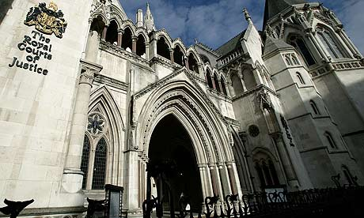
Judicial Review
Issued in October 2015
Challenges the entire UK transposition of Directive 2009/103/EC on motor insurance
  The minister’s decision to approve the changes announced in July 2015
  The minister’s decision to ignore calls for a widely scoped comparative law review
Stay agreed

Slide 21

Emerging Issues
Defining the limits to consistent interpretation
  Case C-397/01 to C-403/01 Bernhard Pfeiffer
Direct effect against the Article 10 Compensating Body
  Farrell v Whitty 2015
    Irish Supreme Court
  Byrne v MIB 2007
    UK High Court

Slide 22

Discussion
Do we need..
A 7th Directive?
A Pan European compliance audit?
Standardised third party policy terms?
Concerning the Article 10 authorised body
  Clarification of its status?
  Better governance?

